Slide 1
Sales Data Analysis & Recommendations
Analyzing Sales Methods for Optimal Revenue
Presented by: Samariddin Zarifov
Date: 03/30/2025

Slide 2
Project Overview & Business Goals
Objective:
Analyze different sales methods to determine the most effective approach.
Business Goals:
Increase revenue by identifying the most successful sales method.
Optimize team effort by focusing on high-performing methods.
Provide data-driven recommendations for sales strategy.

Slide 3
Data Validation & Cleaning
Data Validation Findings:
Corrected inconsistent sales method labels.
Removed 1,074 missing revenue values.
Verified customer ID uniqueness and validated all numerical fields.
Ensured appropriate formatting for all columns.
Key Adjustments:
Standardized sales method categories.
Converted revenue to numeric values.
Dropped missing values for accurate analysis.

Slide 4
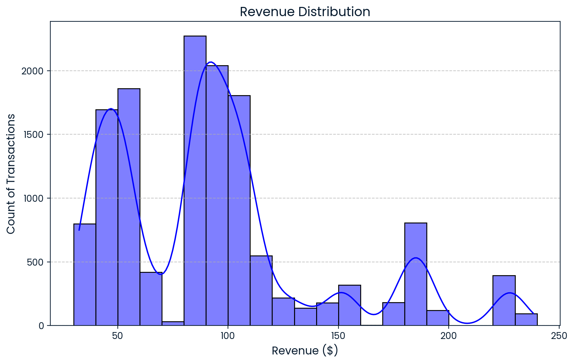
Revenue Distribution Overview
Histogram of Revenue Distribution
Majority of transactions fall under $110.
Peak revenue transactions occur between $80-$90.
Some revenue bins (e.g., 70-80, 160-170, 200-220) show lower transaction volumes.
Key Insight:
Revenue clusters in distinct bands, indicating factors influencing sales patterns.

Slide 5
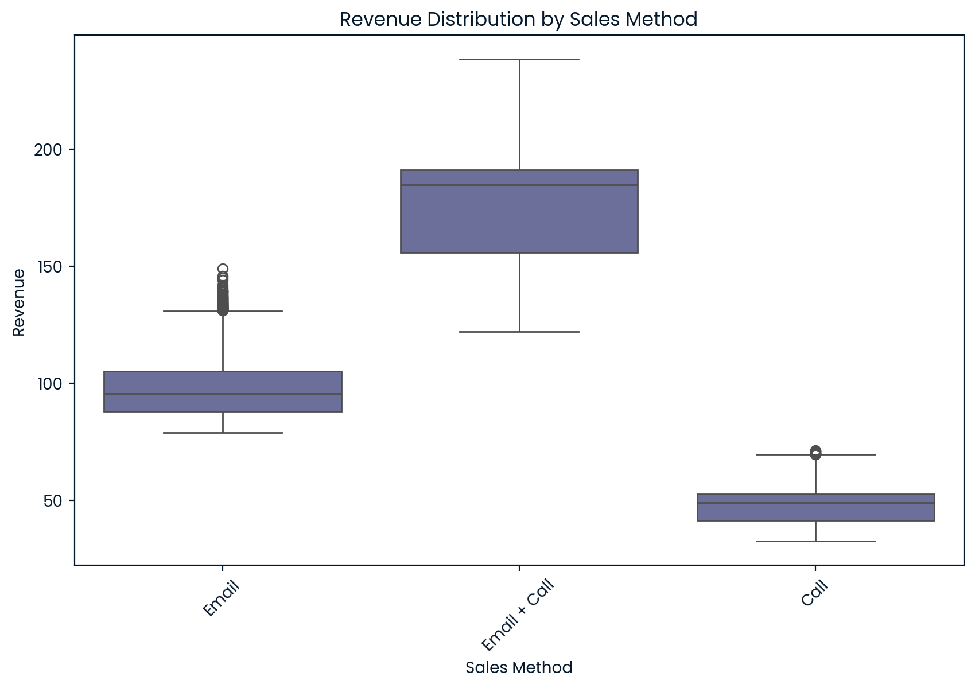
Revenue Distribution by Sales Method
Boxplot Analysis:
Call: Revenue between $25-$70.
Email: Revenue between $75-$150.
Email + Call: Revenue between $125-$240.
Key Insight:
Sales methods segment revenue into three categories.
Email + Call method generates the highest revenue range.

Slide 6
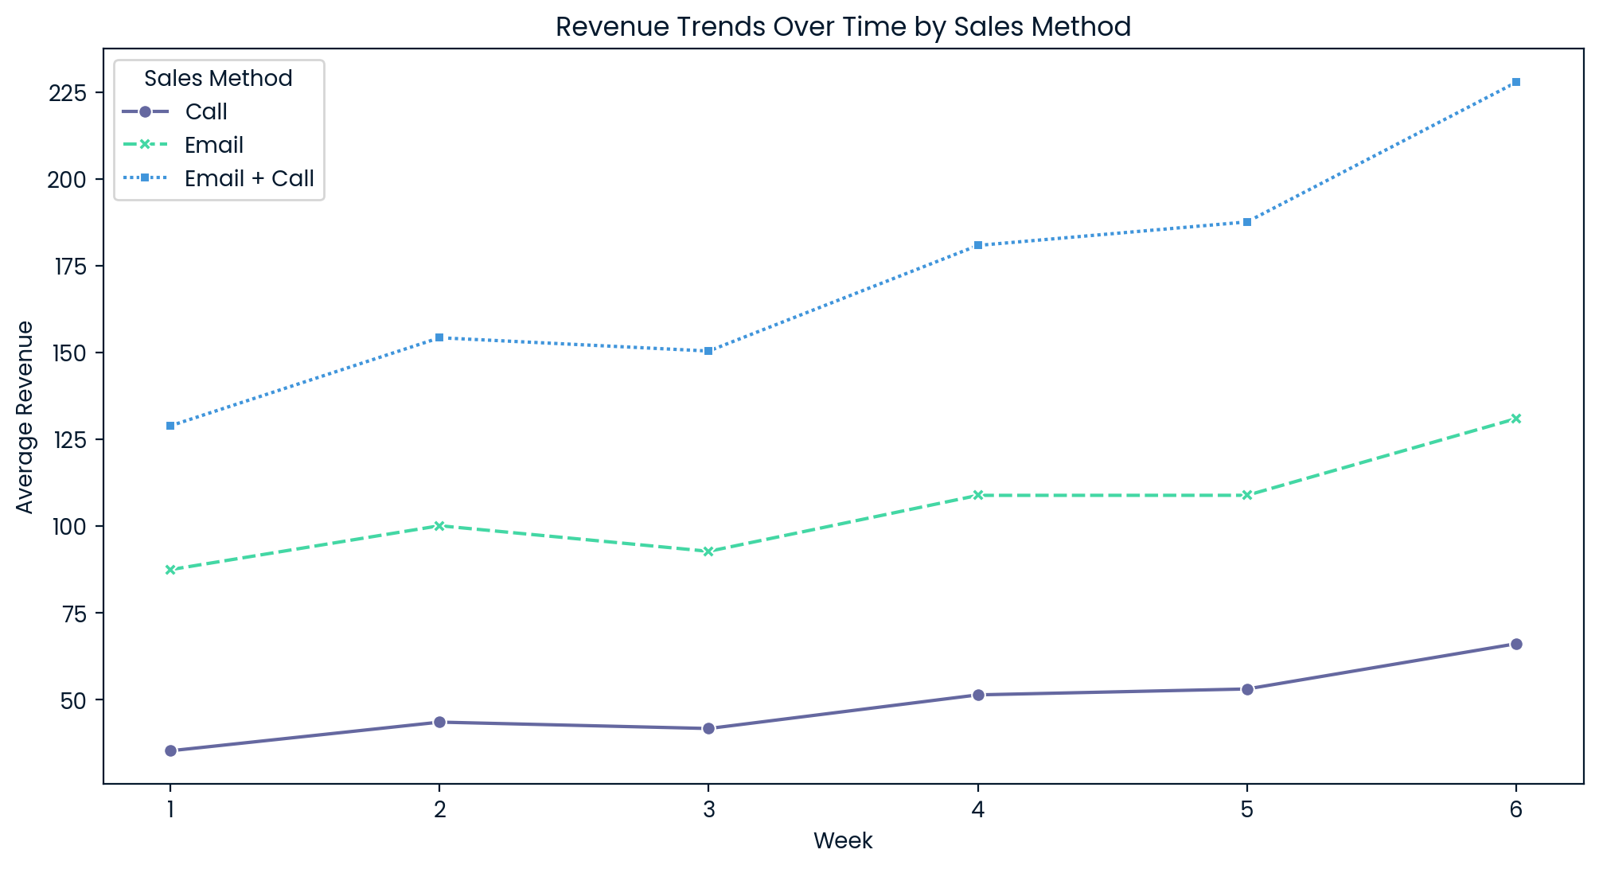
Revenue Trends Over Time by Sales Method
Line Chart of Weekly Revenue Trends
Revenue increased for all sales methods over time.
At least a 2x increase in average revenue per method.
Consistent upward trend suggests improving sales performance.
Key Insight:
Revenue growth suggests sustained improvements in sales effectiveness.

Slide 7
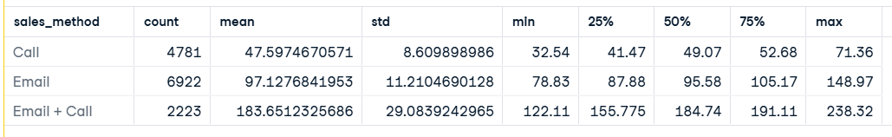
Recommended Metrics for Monitoring
Metrics to Track:
Average revenue per sales method.
Customer conversion rates per method.
Time spent per method vs. revenue generated.
Further data might be more useful for analysis, like customer demographics or how is email or call affecting/what it is telling
Current Estimations:
Email + Call generates the highest revenue but requires balanced effort.
Email alone is efficient but generates moderate revenue.

Slide 8
Business Recommendations
Primary Recommendation:
Prioritize Email + Call method for high revenue generation.
Supporting Strategy:
Use Email as a cost-effective option for lead nurturing.
Reduce reliance on Call-only method due to lower revenue returns.
Consider a hybrid approach: Send emails first, then follow up with calls.
Outcome Expectation:
Higher conversion rates with less team effort per sale.
Improved revenue efficiency.

Slide 9
Conclusion & Next Steps
Summary of Findings:
Sales methods directly impact revenue levels.
Email + Call is the most profitable method.
Revenue growth is steady across all methods.
Next Steps:
Implement Email + Call strategy for key customer segments.
Conduct further A/B testing to refine outreach timing.
Continuously monitor revenue trends for optimizations.

